Slide 1
RegExp constructor
Regular expressions provide a powerful way to validate and manipulate text.
MDN

Slide 2
RegExp constructor
A Regular Expression is a way of representing a pattern you are looking for in a string.
A Regular Expression lets you build patterns using a set of special characters. Depending on whether there's a match, appropriate action can be taken.
People often use regular expressions for validation purposes.
In the validation process: you don't know what exact values the user will enter, but you do know the format they need tuse.

Slide 3
RegExp constructor
pattern
Mandatory parameter, the regular expression you use to match text.
➔Mode/Flag:
Optional parameter, indicates the mode in which the Regular Expression is to be used:
→ (i) ignore case.
→(g) global search.
→(m) Multiline

Slide 4
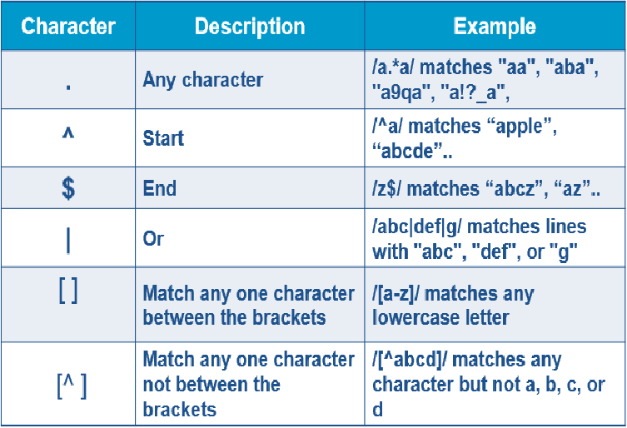
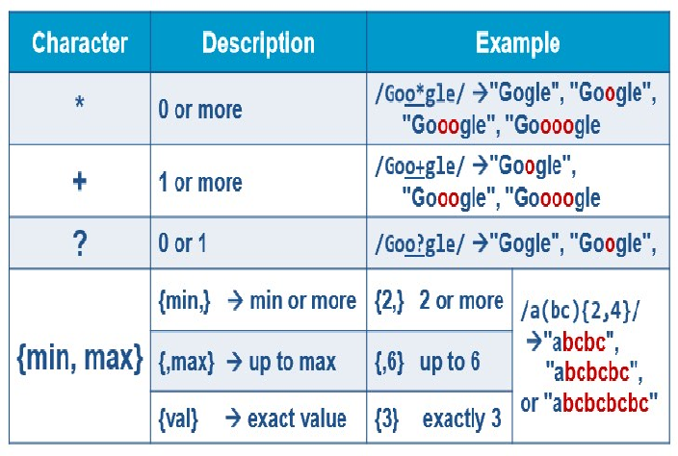
RegExp syntax
w3schools

Slide 5
RegExp constructor - method
RegExp Method test()
returns a boolean (true when there's a match, false otherwise)
/j.*t/.test("Javascript") ==> false (case sensitive)
/j.*t/i.test("Javascript") ==> true
String methods that accepts an RegExp as a parameter
replace: allows to substitue matched text with another string
search: retruns the postion of the first match
match : returns array of matches

Slide 6
Date object constructor
Date instance that represents a single moment in time.
MDN

Slide 7
Date object constructor
Object to manipulate date and time based on the local machine time.
Examples:
var d=new Date() //returns date of local machine now
Note: The argument month Index is 0-based. This means that January = 0 and December = 11.
var d = new Date(2008, 1, 1); //31/1/2008
var weekday = d.getDay( ); //0 ➔ Sunday

Slide 8
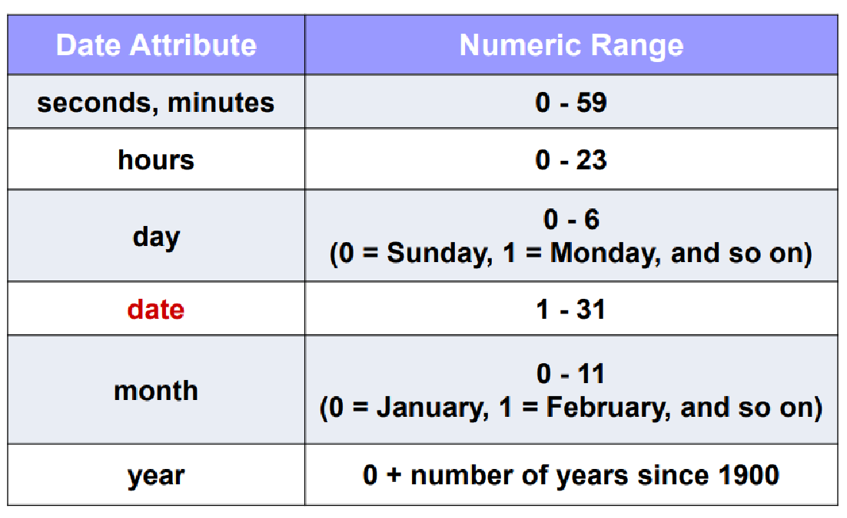
Date Object- Number Conventions
w3schoolss

Slide 9
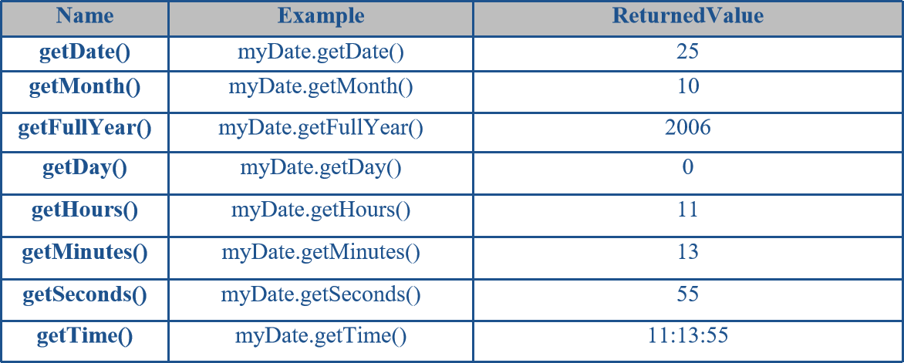
Date Object- methods
var myDate= new Date ( "November 25,2006 11:13:55");
w3schools
1164446035000
the number of milliseconds since the epoch (1970-1-1)

Slide 10
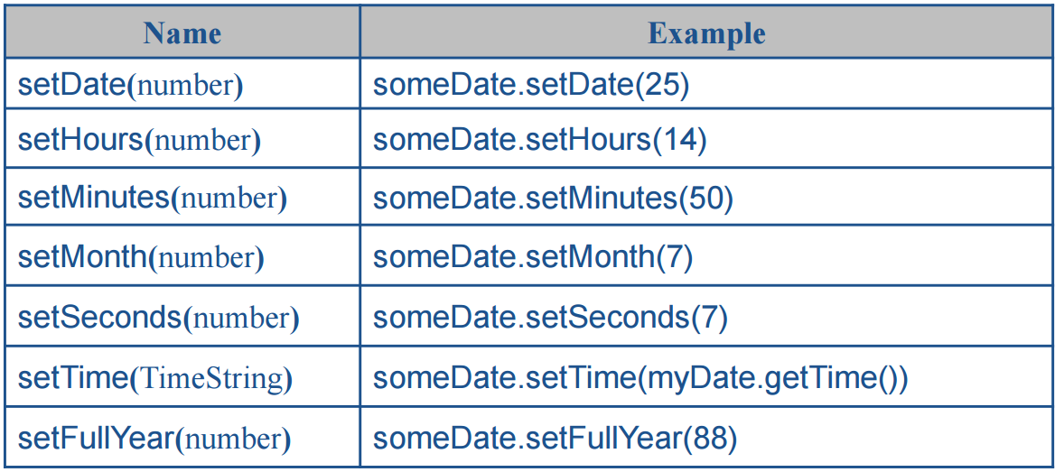
Date Object- methods
var myDate= new Date ( "November 25,2006 11:13:55");
w3schools

Slide 11
Date Object- methods
var myDate= new Date ( "November 25,2006 11:13:55");
w3schools
Name | Example | ReturnedValue
toUTCString() | myDate.toUTCString() | Sat ,25 Nov 2006 09:13:00UTC
toLocaleString() | myDate.toLocaleString(“ko-kr”) | 2006. 11. 25. 오전 11:13:55 (default language depends on the locale setup on your computer OS)
toLocaleTimeString() | myDate.toLocaleTimeString() | ص11:13:00
toLocaleDateString() | myDate.toLocaleDateString() | 25نوفمبر,2006
toString() | myDate.toString() | Sat Nov 25 11:13:00 UTC +0200 2006
toDateString() | myDate.toDateString() | Sun Nov 1 2006

Slide 12
Litral object
What is an Object?
An object is an unordered list of primitive data types (and sometimes reference data types) that is stored as a series of name-value pairs.
Each item in the list is called a property (functions are called methods)
MDN

Slide 13
Litral object
creating object with some properties
var emp1=new Object( { Name: "Richard", Age: 30} );
var emp2={Name:”Ali”, Age:20};
using object you don’t need to create instance
emp1. Name=“Mahmoud”;
alert(emp1.Name);
Adding Methods to the object
var emp2={ name:“Aly", age: 23,
show : function ( ){
alert(this.name + " is " + this.age + " years old.“);
}
};
calling method, and again you don’t need to create instance
emp2.show();

Slide 14
Object category
objects types
built in
Hosting objects
custom Object
Number
DOM
String
Date
BOM
. . .

Slide 15
BOM model
window
screen
location
navigator
history
event
document
The window is the global object in JavaScript object hierarchy

Slide 16
window object
The top level object in the JavaScript object hierarchy.
The Window object represents a browser window.
Window object has a set of properties & methods
MDN

Slide 17
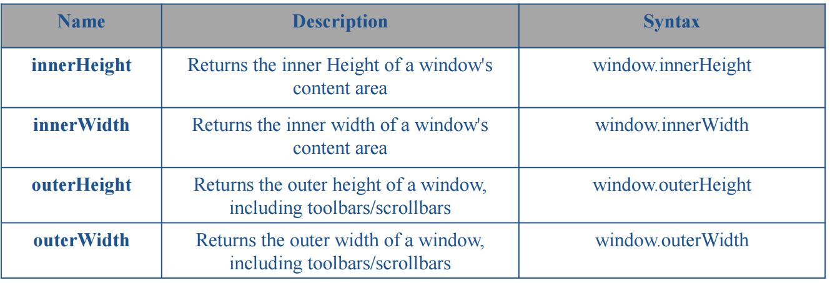
Window object - properties
w3schools

Slide 18
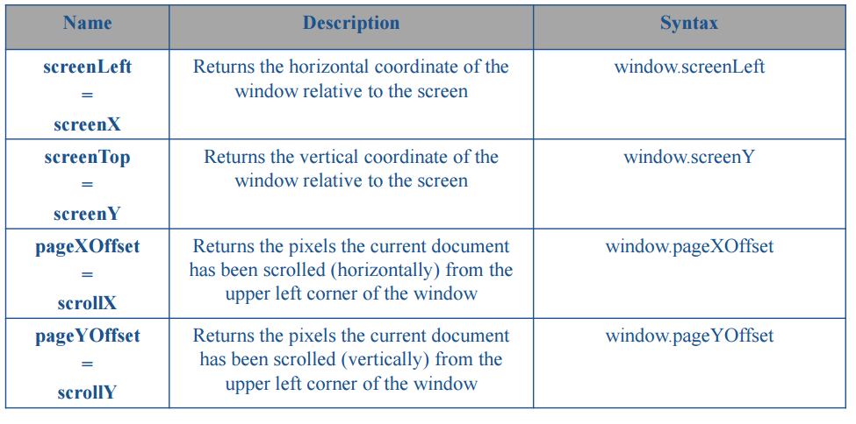
Window object - properties
w3schools

Slide 19
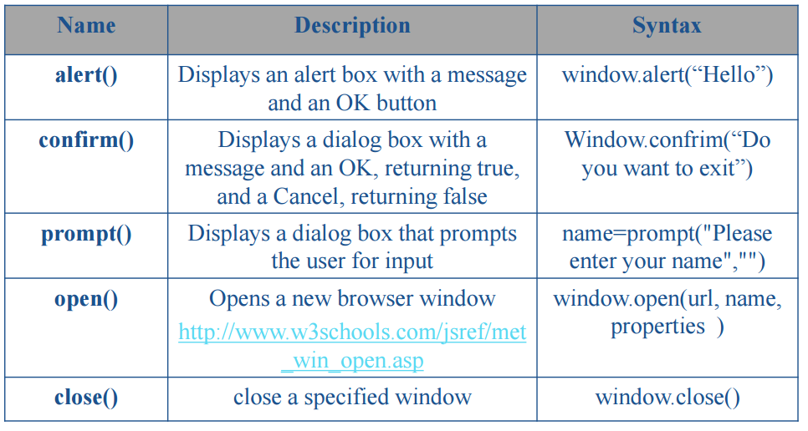
Window object - methods
w3schools

Slide 20
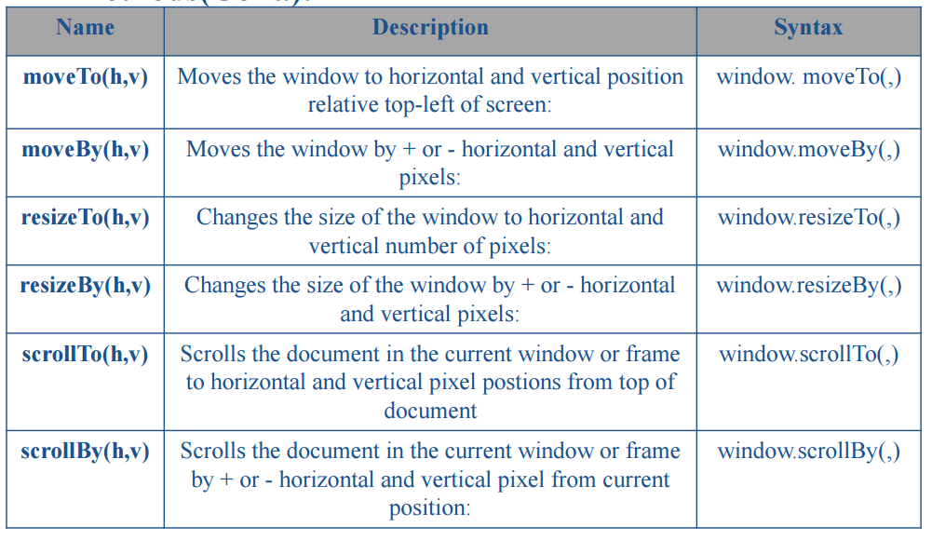
Window object - methods
w3schools

Slide 21
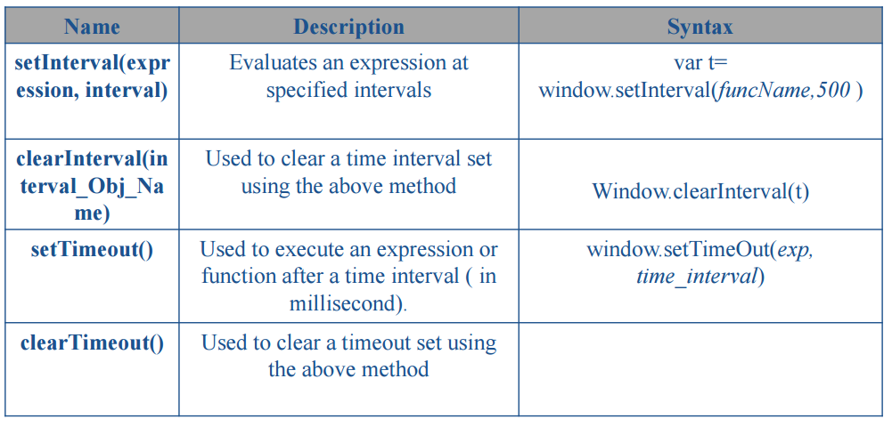
Window object - Timing methods
w3schools

Slide 22
ADDITIONAL RESOURCES
Understanding js object prototypes with CSS :https://medium.com/free-code-camp/understanding-prototypal-inheritance-in-javascript-with-css-93b2fcda75e4
Object in Js : https://developer.mozilla.org/en-US/docs/Learn/JavaScript/Objects/Basics
js and prototype-base : https://developer.mozilla.org/en-US/docs/Web/JavaScript/Inheritance_and_the_prototype_chain
this in objects : https://developer.mozilla.org/en-US/docs/Learn/JavaScript/Objects/Basics#what_is_this
Object prototype: https://developer.mozilla.org/en-US/docs/Learn/JavaScript/Objects/Object_prototypes

